Slide 1
Multi Cloud Service management

Slide 2

Cloud service

Slide 3
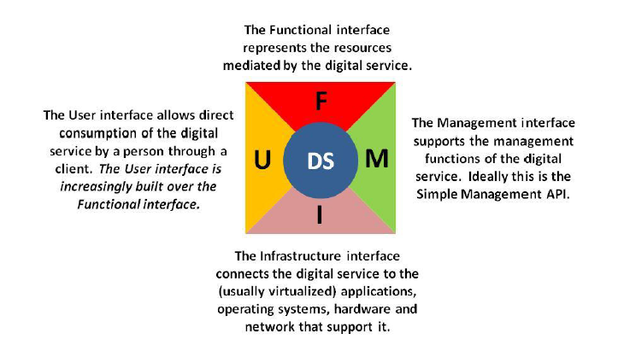
Digital Service

Slide 4
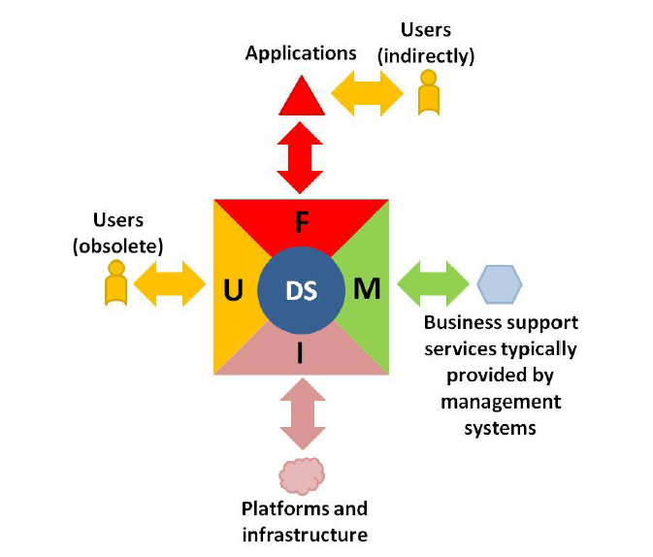
Consumer of Digital Service

Slide 5
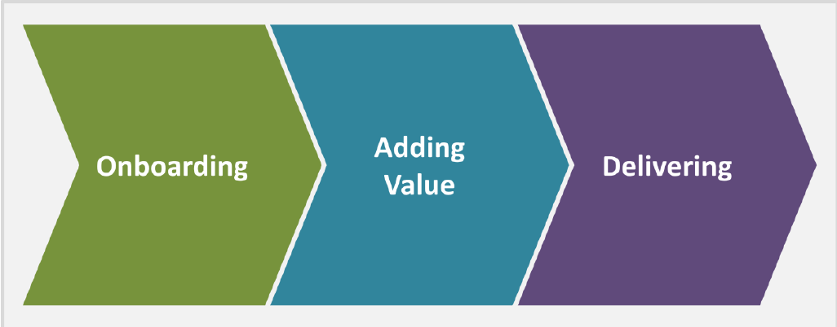
Digital Service lifestyle

Slide 6


Contd.

Slide 7




Value Addition and Delivery

Slide 8

Some Cloud Service

Slide 9
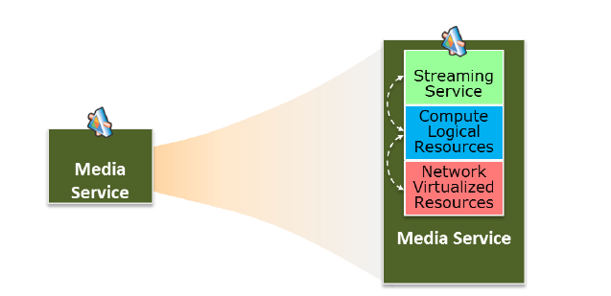
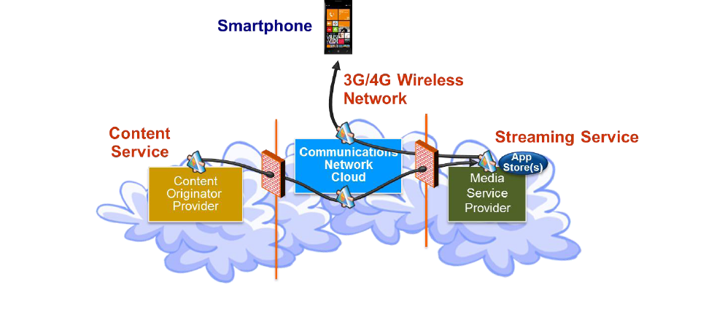
Content streaming

Slide 10
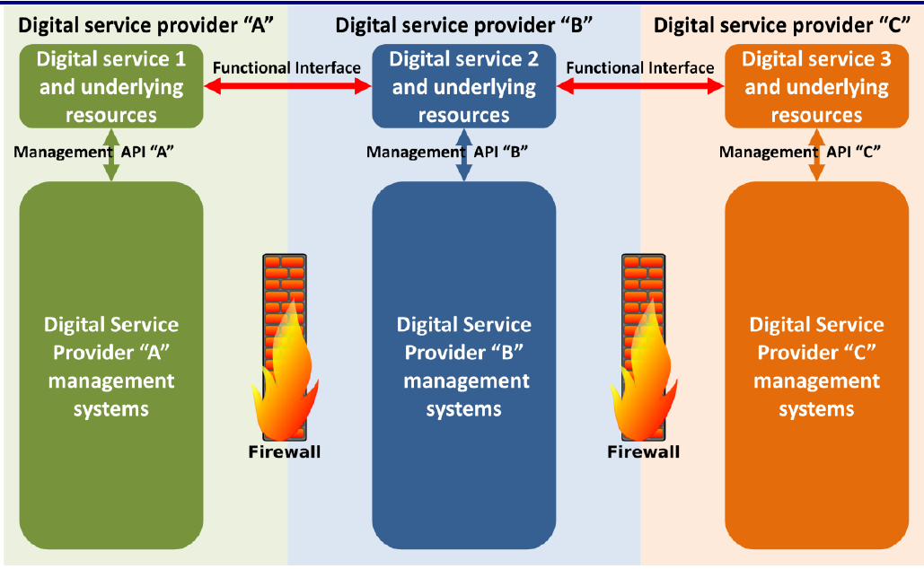
Visibility Problem

Slide 11
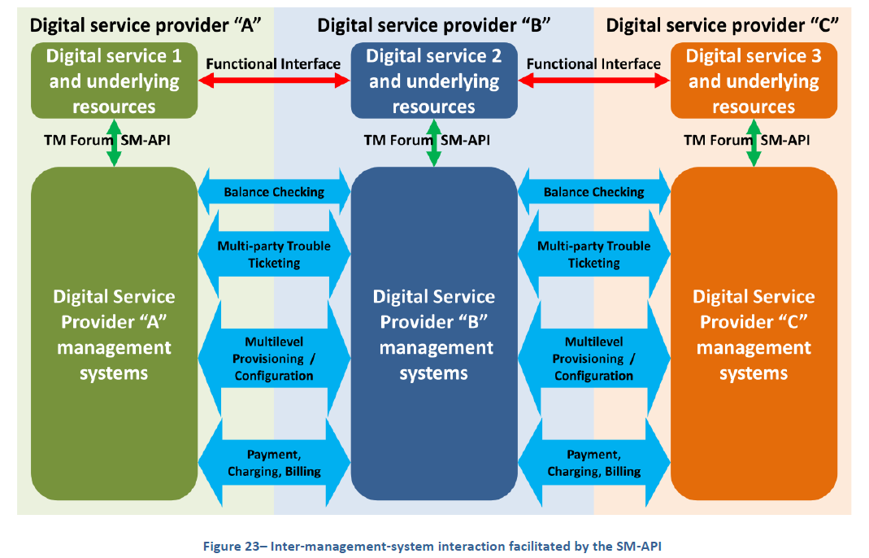

Slide 12
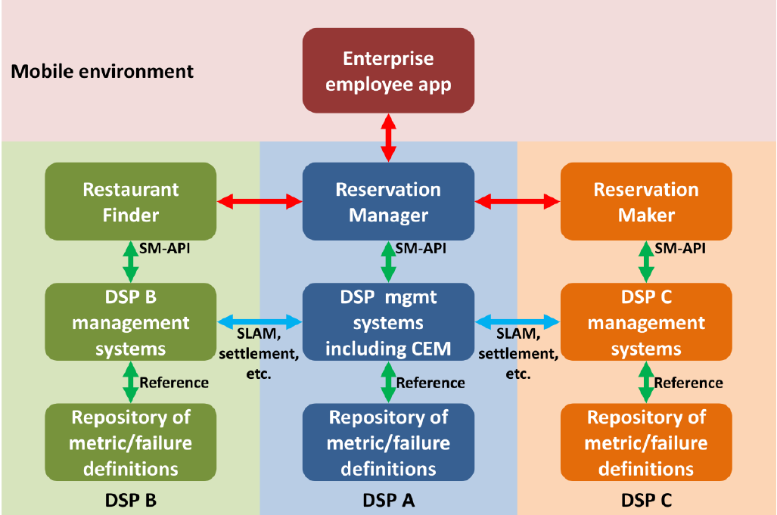
Metrics Collection

Slide 13
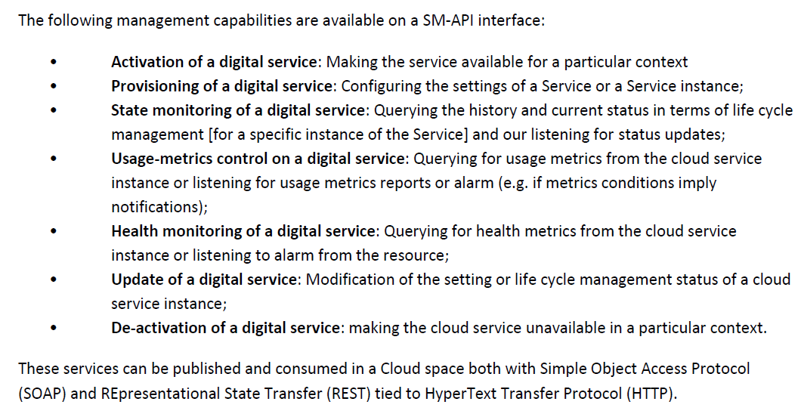
SM-API

Slide 14

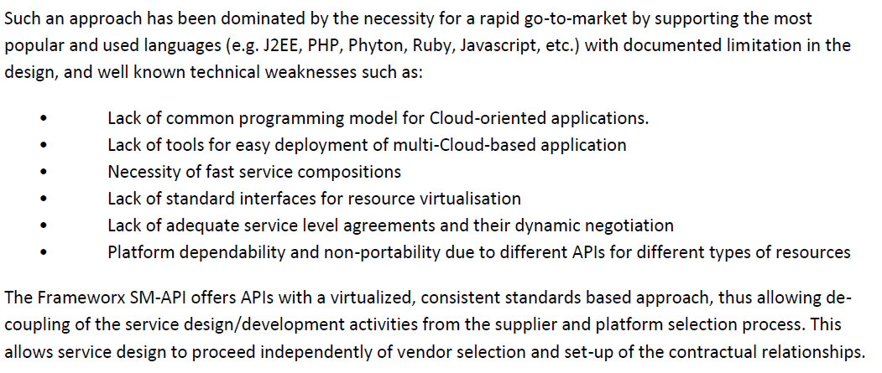
contd

Slide 15
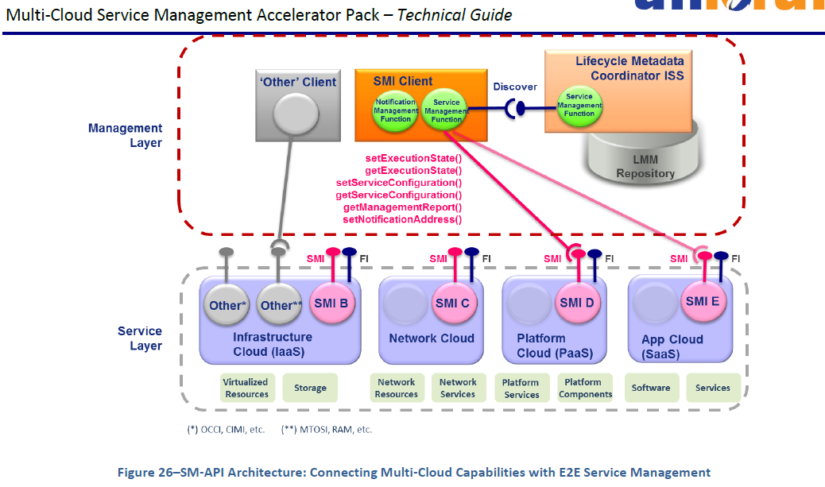
SM API Architecture

Slide 16
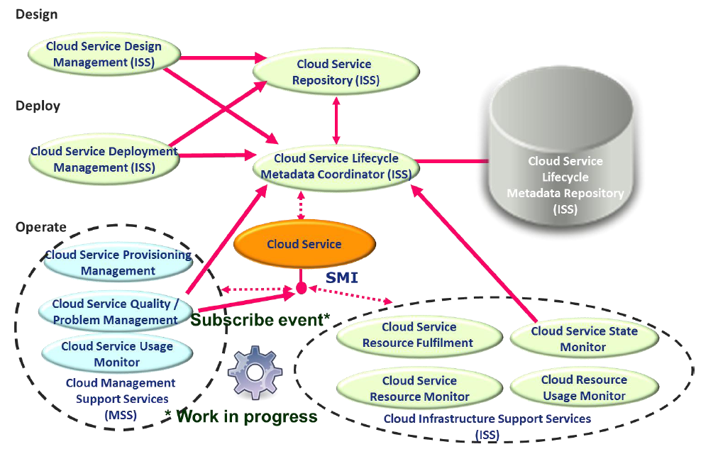
Cloud Reference Architecture

Slide 17
